Slide 1
OWASP Application Security Verification Standard 2009
– Web Application Standard
The ASVS Team

Slide 2

Agenda
  About ASVS
  Project Status
  Technical Details
  Getting Started
  Where to Go from Here
  Questions
The OWASP Foundation
http://www.owasp.org

Slide 3

Challenges…
There is a huge range in coverage and rigor available in the application security verification market!
Consumers have no way to tell the difference between:
  Someone running a grep tool, and
  Someone doing painstaking code review and manual testing!
There are differences in coverage and rigor between types of tools, between tools and manual techniques, and between types of manual techniques!

Slide 4

Philosophy of ASVS
It is intended as a standard for how to verify the security of web applications
It should be application-independent
It should be development life-cycle independent
It should define requirements that can be applied across web applications without special interpretation
Design Goals:
The standard should define increasing levels of application security verification
The difference in coverage and level of rigor between levels should be relatively linear
The standard should define functional verification requirements that take a white-list (i.e., positive) approach
The standard should also be verification tool and technique independent!
Any such standard also needs to be commercially-viable and therefore not overly burdensome!

Slide 5

What Questions Does ASVS Answer?
What security features should be built into the required set of security controls?
What are reasonable increases in coverage and level of rigor when verifying the security of a web application?
How can I compare verification efforts?
How much trust can be placed in a web application?
A Success Story:
Application Security Verification Standards are specifications produced by OWASP in cooperation with secure applications developers and verifiers worldwide for the purpose of accelerating the deployment of secure web applications. First published in 2008 as a result of an OWASP Summer of Code grant and meetings with a small group of early adopters, the ASVS documents have become widely referenced and implemented.
ASVS can answer these questions for applications ranging from minimum risk applications, to critical infrastructure applications.

Slide 6
Agenda
  About ASVS
  Project Status
  Technical Details
  Getting Started
  Where to Go from Here
  Questions
The OWASP Foundation
http://www.owasp.org

Slide 7
What is the status of the ASVS as an OWASP standard?
Web Application Standard
  It is the first OWASP standard
  Current version is now Release quality, released June 2009
  Project Lead: Mike Boberski (Booz Allen)
  Co-authors: Jeff Williams, Dave Wichers (Aspect Security)
  Piloted by Booz Allen Hamilton
  ASVS assessments now being offered by firms including Aspect Security and Booz Allen
Future ASVS Standards:
Web Services Standard next on the roadmap
Translate to other languages (e.g. Spanish)
Additional architectures being considered (perhaps client-server, Cloud computing for example)

Slide 8


Project Plan and Status
06/09 – OWASP ASVS “Release”
12/08 – OWASP ASVS “Beta”
10/08 – OWASP ASVS “Alpha”
04/08 – OWASP ASVS “RFP” (OWASP Summer of Code 2008)
Check out the ASVS project page for the latest news: http://www.owasp.org/index.php/ASVS

Slide 9
Agenda
  About ASVS
  Project Status
  Technical Details
  Getting Started
  Where to Go from Here
  Questions
The OWASP Foundation
http://www.owasp.org

Slide 10
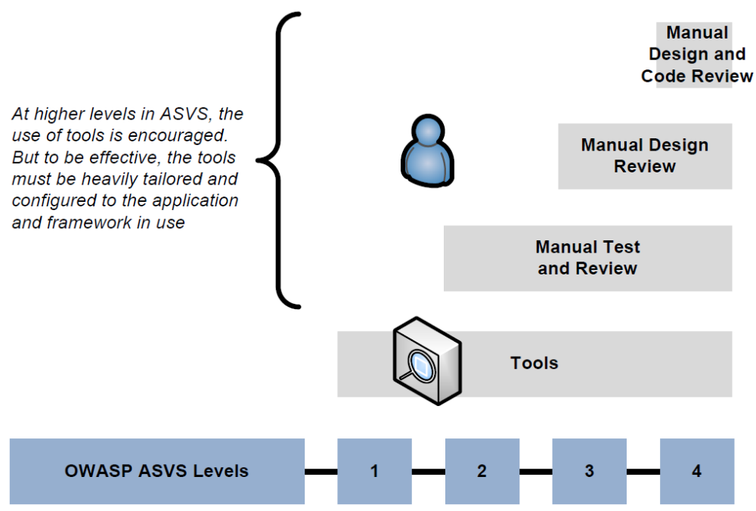
What are ASVS Verification Levels?

Slide 11








Application Security Verification Techniques
Find Vulnerabilities
Using the Running Application
Find Vulnerabilities
Using the Source Code
Manual Application
Penetration Testing
Manual Security
Code Review
Automated Application Vulnerability Scanning
Automated Static
Code Analysis
Notes:
You have a number of options when verifying the security of an application. The standard gives you the flexibility to use any and all of these options in your verification effort.

Slide 12
Level Definitions
Level 1 – Automated Verification
    Level 1A – Dynamic Scan (Partial Automated Verification)
    Level 1B – Source Code Scan (Partial Automated Verification)
Level 2 – Manual Verification
    Level 2A – Penetration Test (Partial Manual Verification)
    Level 2B – Code Review (Partial Manual Verification)
Level 3 – Design Verification
Level 4 – Internal Verification

Slide 13
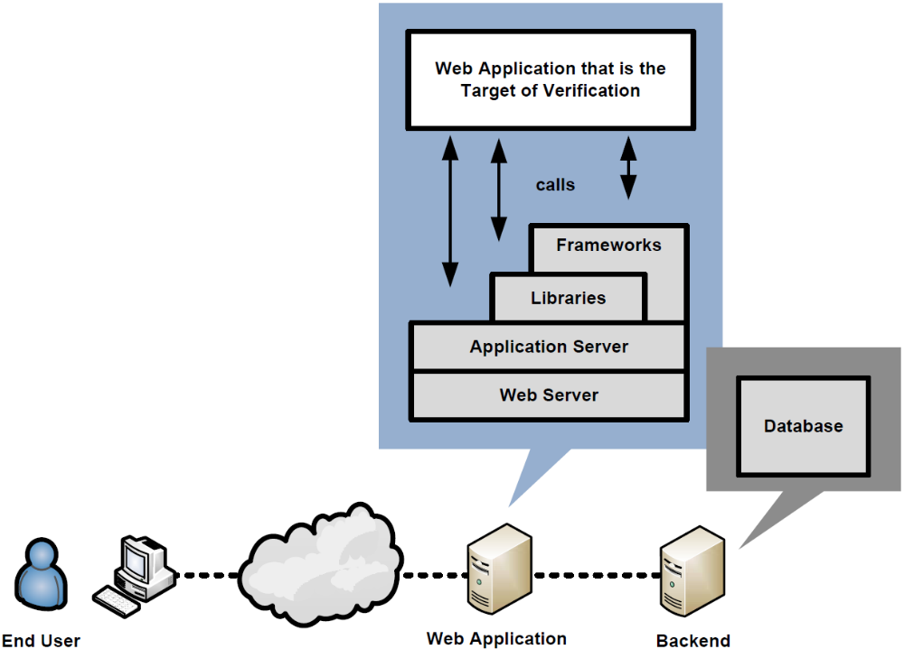
Level 1 in more detail
Automated verification of a web application treated as groups of components within single monolithic entity
Notes:
The point is, that at this level, your application can be considered one big blob of code. No breakdown of the application or architecture is required.

Slide 14
Level 1 Options
Level 1A
Dynamic Scan (Partial Automated Verification)
Level 1B
Source Code Scan (Partial Automated Verification)
Need BOTH to achieve a full level 1…
Notes:
Whichever tool or tools you use must provide coverage against all the requirements in the standard. Covering a requirement simply means that the tool provides some benefit in that area. Not that it necessarily finds ALL flaws in that area. For example, if the tool can find some XSS flaws, that it is considered to cover that area at Level 1, even though it can’t find all XSS flaws in a particular application.
If there is a level 1 (A or B) requirement that your selected tool suite doesn’t cover, then you can augment your verification process with manual verification to address that particular requirement.

Slide 15
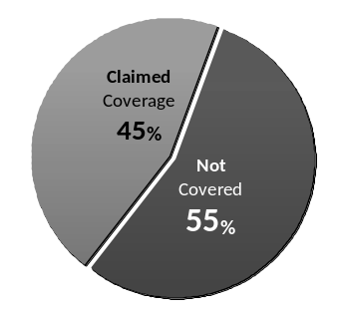
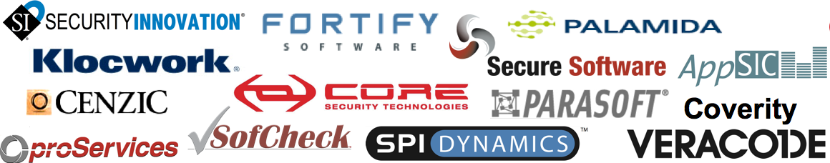

Tools – At Best 45%
    MITRE found that all application security tool vendors’ claims put together cover only 45% of the known vulnerability types (695)
    They found very little overlap between tools, so to get 45% you need them all (assuming their claims are true)
Notes:
Note: Clearly a level 1 review can’t do any more than what the tools can do, since it’s a tool based review. Given that tools don’t yet provide a huge amount of coverage of the application security problem space, level 1 reviews are understandable limited in their scope. But they are just the first level in the model. Higher levels provide better coverage and more rigor, as defined by the standard itself.

Slide 16
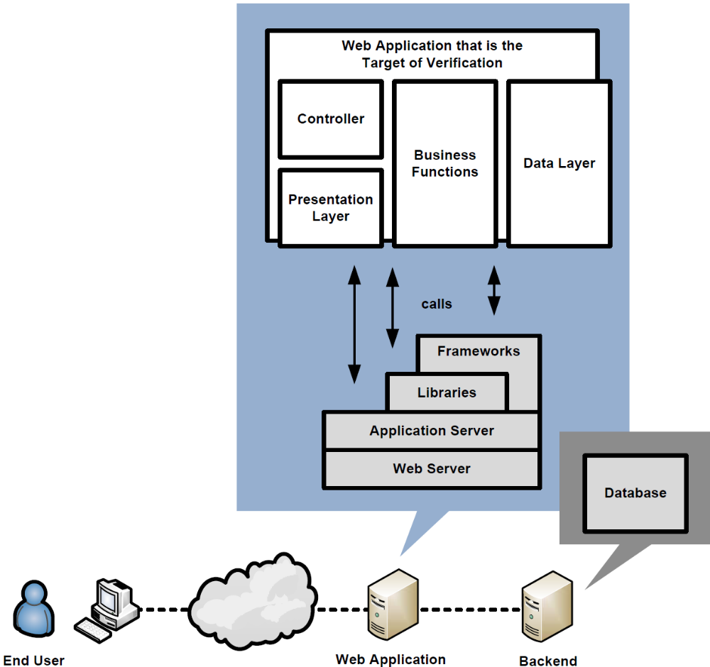
Level 2 in more detail
Manual verification of a web application organized into a high-level architecture.
Notes:
At level 2, the verifier needs to clearly articulate the architecture of your application at a high level, clearly identifying all custom components, and all commercial or open source components used in the application, and their purpose in the architecture.

Slide 17
Level 2 Options
Level 2A
Manual Penetration Test
Level 2B
Manual Code Review
Need BOTH to achieve a full level 2…
Notes:
Manual verification can also leverage the use of automated tools, but it doesn’t have to. Manual verification WILL involve the use of tools. It will be crazy not to. However, the level of ‘automation’ of such tools is up to the verifier. It could range from the simple use of an IDE, to automated commercial tools like what might be used at level 1, to custom code review tools that have custom rules built and maintained by the verifier that are not commercially available.

Slide 18
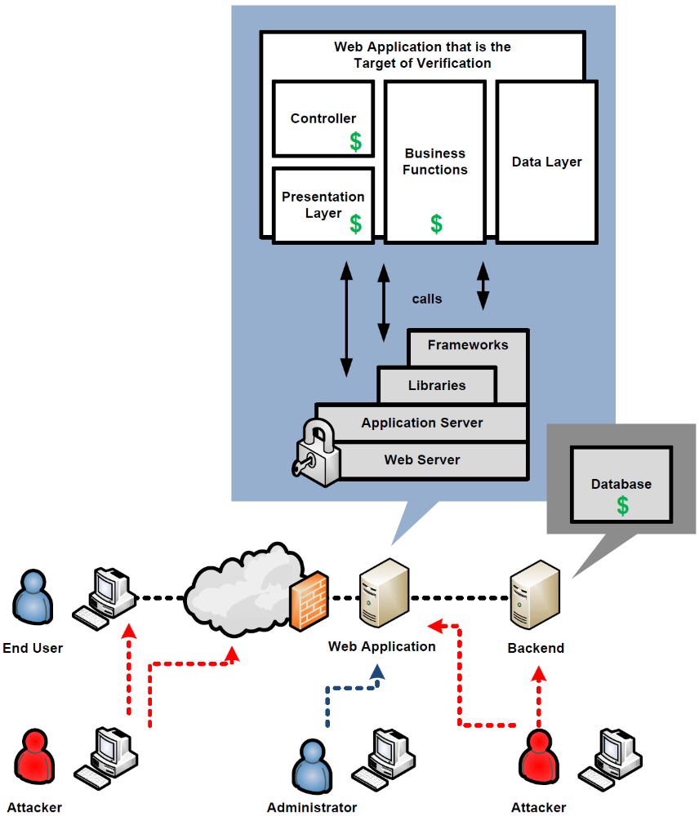
Level 3 in more detail
Level 2 + Threat modeling information to verify design
Notes:
Level 3, is Level 2 plus more coverage and more depth of analysis. It also include high level threat modeling and design verification, to verify that all the critical assets are protected by the proper set of security controls.

Slide 19
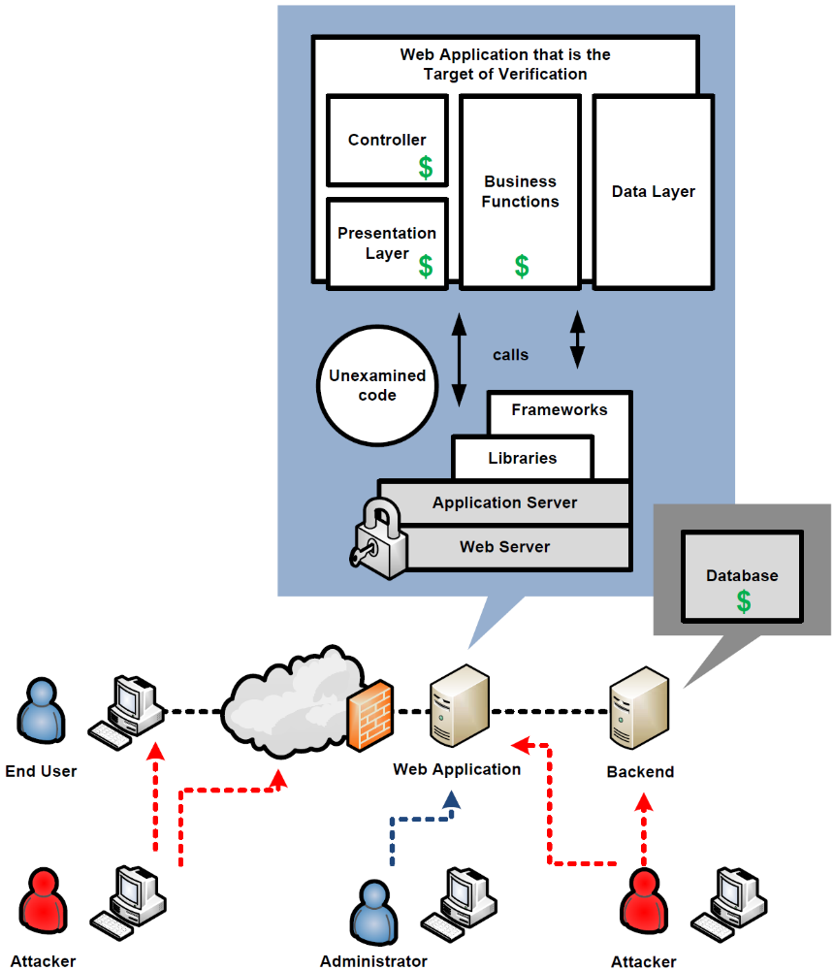
Level 4 in more detail
Internal verification of a web application by searching for malicious code (not malware) and examining how security controls work.

Slide 20
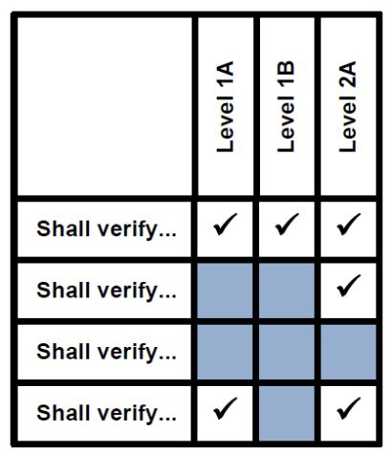
What are the ASVS Verification Requirements?
Security architecture verification requirements
Security control verification requirements
Security architecture information puts verification results into context and helps testers and reviewers to determine if the verification was accurate and complete.

Slide 21

A positive approach
Negative
  The tester shall search for XSS holes
Positive
  Verify that all HTML output that includes user supplied input is properly escaped
See: http://www.owasp.org/index.php/XSS_(Cross_Site_Scripting)_Prevention_Cheat_Sheet
Technology and threats change over time! ASVS takes a proactive a white-list approach.

Slide 22
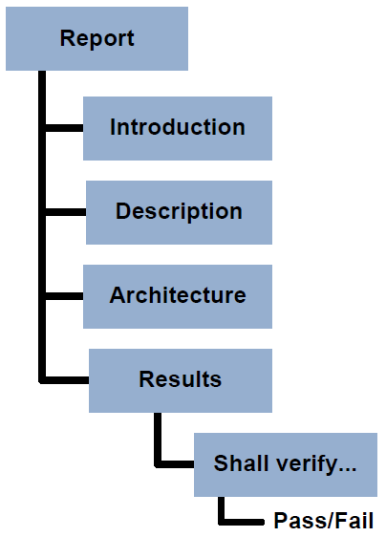
What are ASVS reporting requirements?
R1 – Report Introduction
R2 – Application Description
R3 – Application Architecture
R4 – Verification Results
Is the report sufficiently detailed to make verification repeatable? Is there enough information to determine if the verification was accurate and complete?

Slide 23
Agenda
  About ASVS
  Project Status
  Technical Details
  Getting Started
  Where to Go from Here
  Questions
The OWASP Foundation
http://www.owasp.org

Slide 24
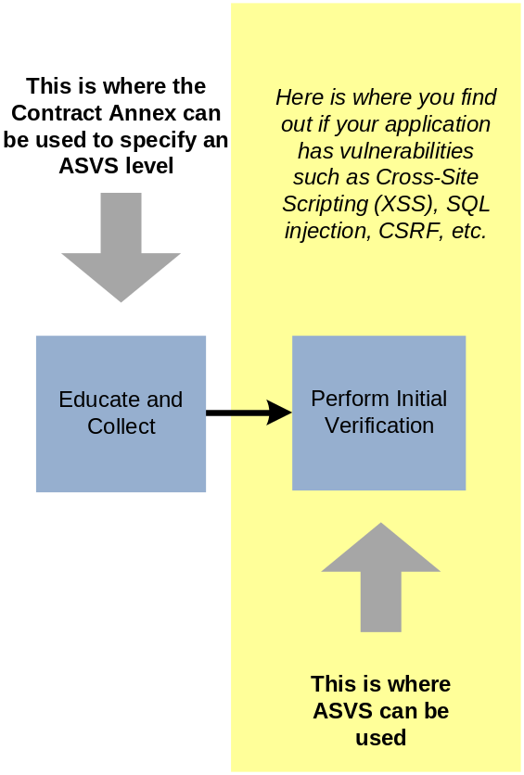

How do I get started using ASVS?
Buyer and seller: agree how technical security requirements will be verified by specifying a level from 1 to 4
Perform an initial verification of the application
Using ASVS requires planning and in that respect is just like any other testing exercise!

Slide 25
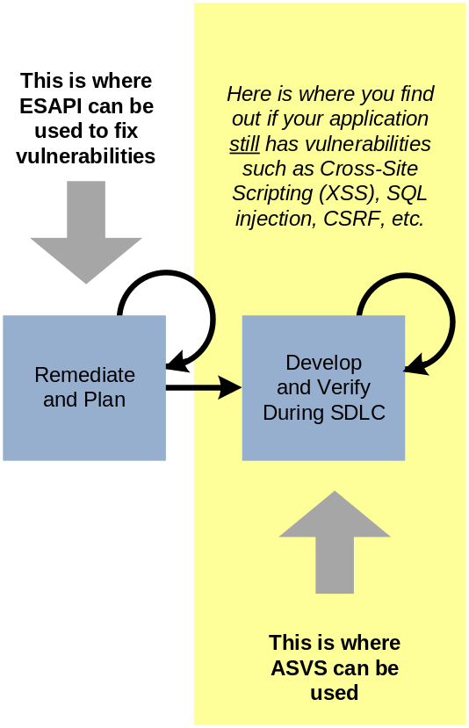

How do I get started using ASVS? (continued)
Develop and execute a remediation strategy,
Re-verify after fixes are made (repeat as necessary).
Develop a strategy to add verifications into the SDLC as regular activities.
Tip: don’t scare people when you present your findings! Be specific. Propose a specific fix or a workaround, if able.

Slide 26
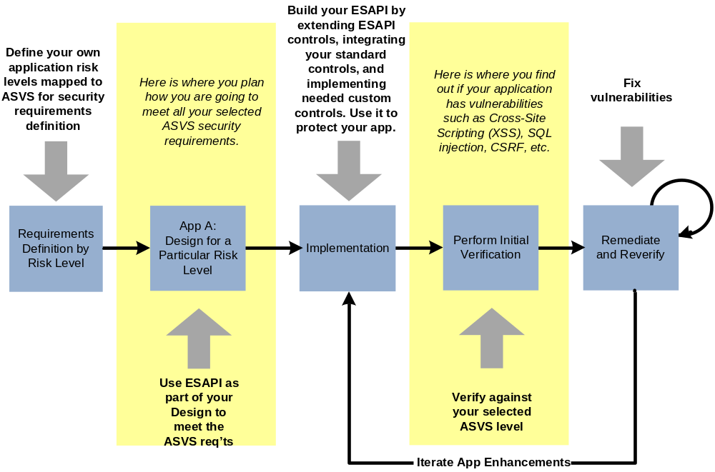
Integrating ASVS into your SDLC
(Outsourcing not required)

Slide 27
Agenda
  About ASVS
  Project Status
  Technical Details
  Getting Started
  Where to Go from Here
  Questions
The OWASP Foundation
http://www.owasp.org

Slide 28
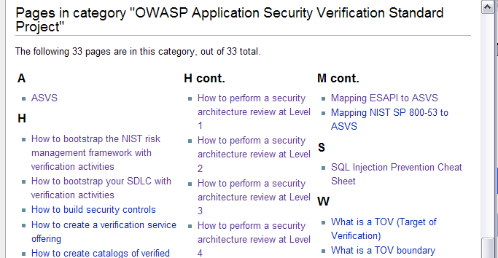
Where can I find help getting started using ASVS?
You can find information on the ASVS Project Page where there are articles at the bottom of the page
  http://www.owasp.org/index.php/ASVS

Slide 29

Where can I get a copy of ASVS, and talk to people using ASVS?
You can download a copy from the ASVS Project page:
  http://www.owasp.org/index.php/ASVS
You can send comments and suggestions for improvement using the project mailing list:
  See “Mailing List/Subscribe” link on project web page.
  Tell us how your organization is using the OWASP ASVS. Include your name, organization's name, and brief description of how you are using the ASVS
Tip: Subscribe to the OWASP ASVS mailing list!
Owasp-Application-Security-Verification-Standard@lists.owasp.org

Slide 30
Agenda
  About ASVS
  Project Status
  Technical Details
  Getting Started
  Where to Go from Here
  Questions
The OWASP Foundation
http://www.owasp.org

Slide 31

Questions?

